Slide 1
Investing and trading platform
Samridh Anand
Shravya Nandayal
Sharanya B R

Slide 2
CONTENTS
Introduction
Problem Statement
Approach
Future Goals
Outputs and Code snippets

Slide 3
INTRODUCTION
The stock market is a component of a free-market economy. It allows companies to raise money by offering stock shares and corporate bonds and allows investors to participate in the financial achievements of the companies, make profits through capital gains, and earn income through dividends.

Slide 4
Problem Statement
Trading/Investing can seem to be intimidating at first. How can the experience be simplified for newborn traders?

Slide 5
Our Approach
Simple and Clean UI
We designed a website with super minimal UI
We hide all the extra information (can be viewed if wanted to)
Don’t try it with your money!
As the currency you trade with on our platform isn’t real, you can invest as you like without the risk of losing anything
Our platform is a replica of real stock world and gives you experience of the real thing so you can be ready for the real thing.

Slide 6
Solution to the technical Challenges
Tech stack used
Express : It enables us to create our own live server so all your actions are registered real time
MongoDB : This is the database we use to store all your data
React : To provide you the simple and clean UI
NodeJS : We used nodejs and it’s packages to speed up our development, some of the modules used are
Mongoose
Axios
Bcrypt

Slide 7
Future Goals
We are still working on many new features such as
Being able to add more virtual money
Trade not just stocks, but crypto as well!
A more rich user experience

Slide 8
Output and code snippets

Slide 9
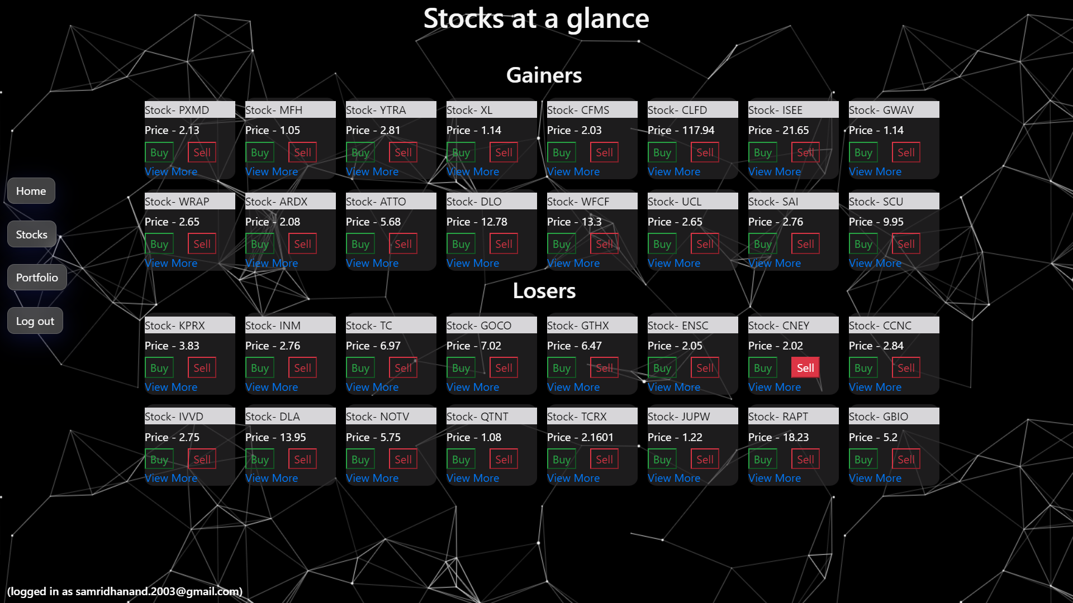

Slide 10
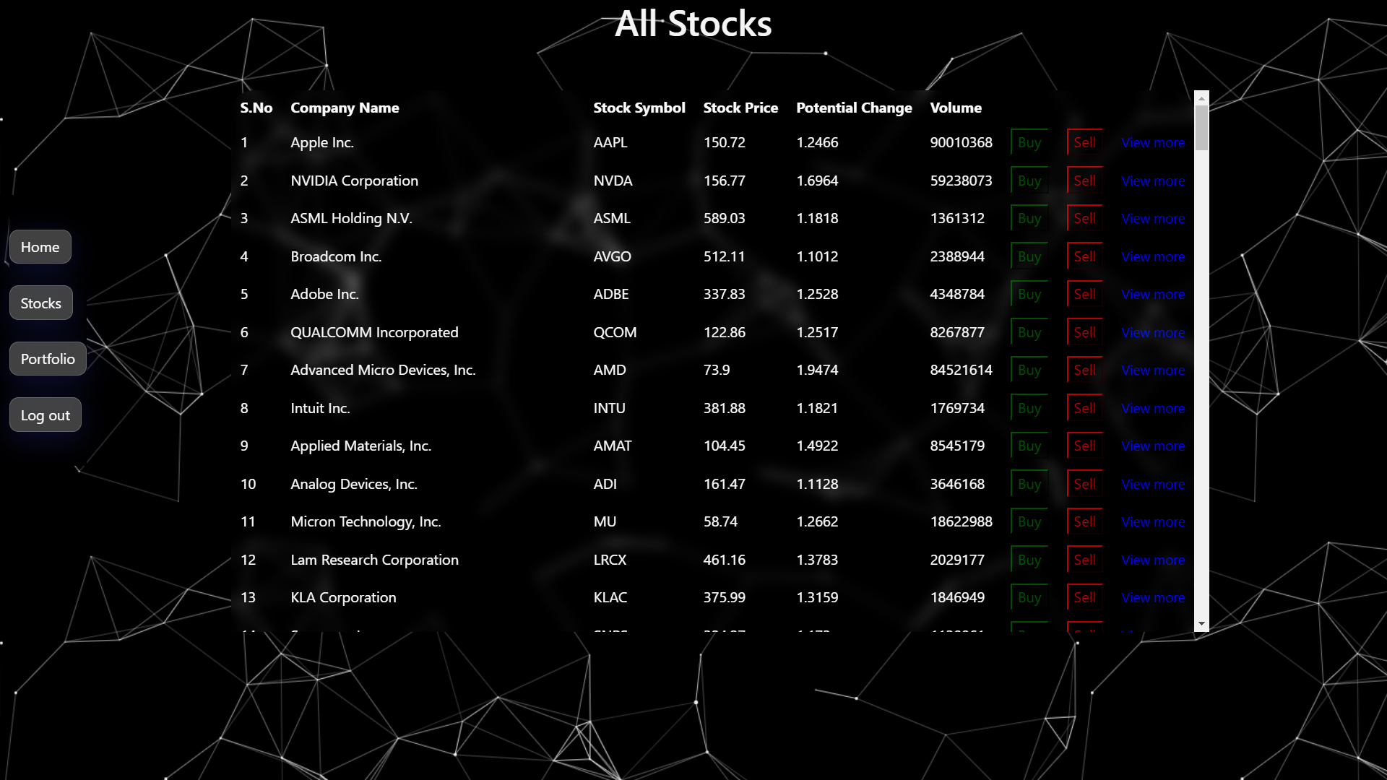

Slide 11
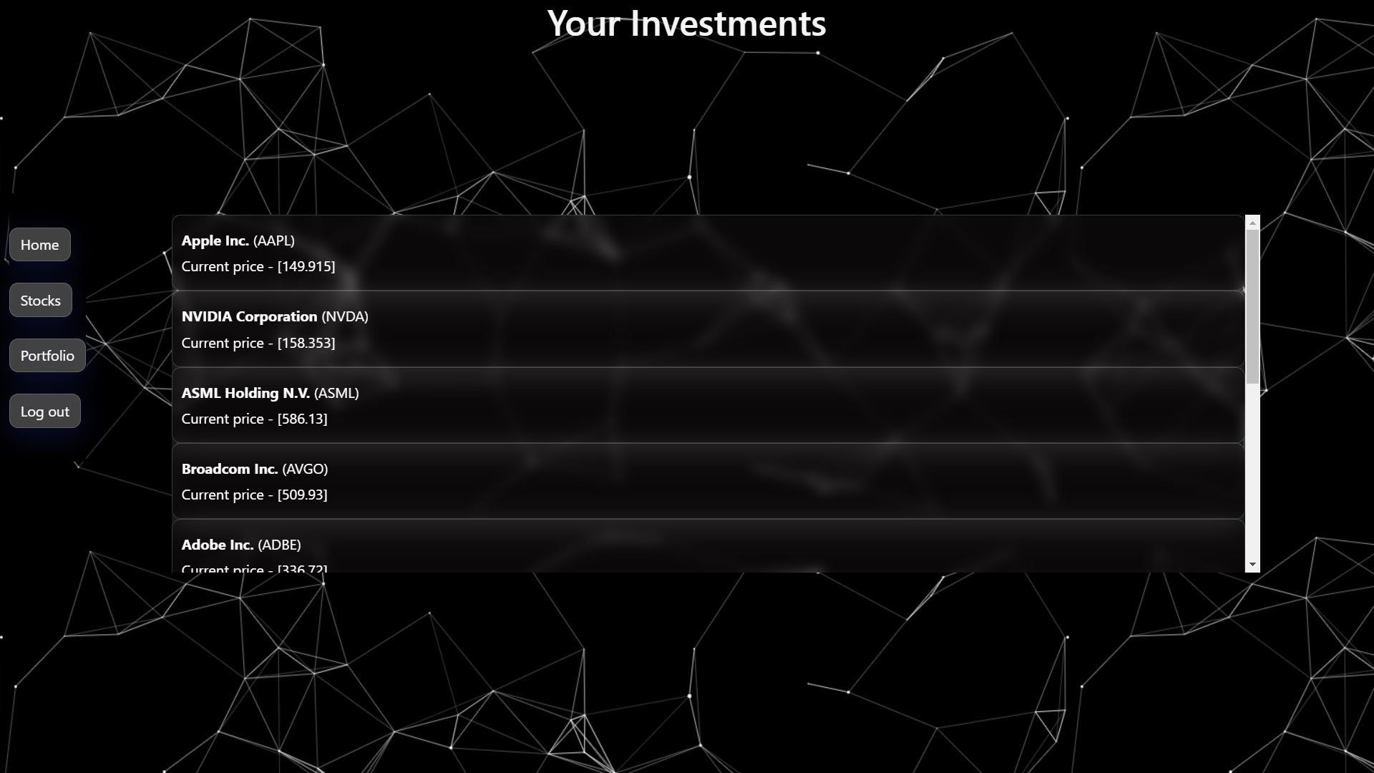

Slide 12
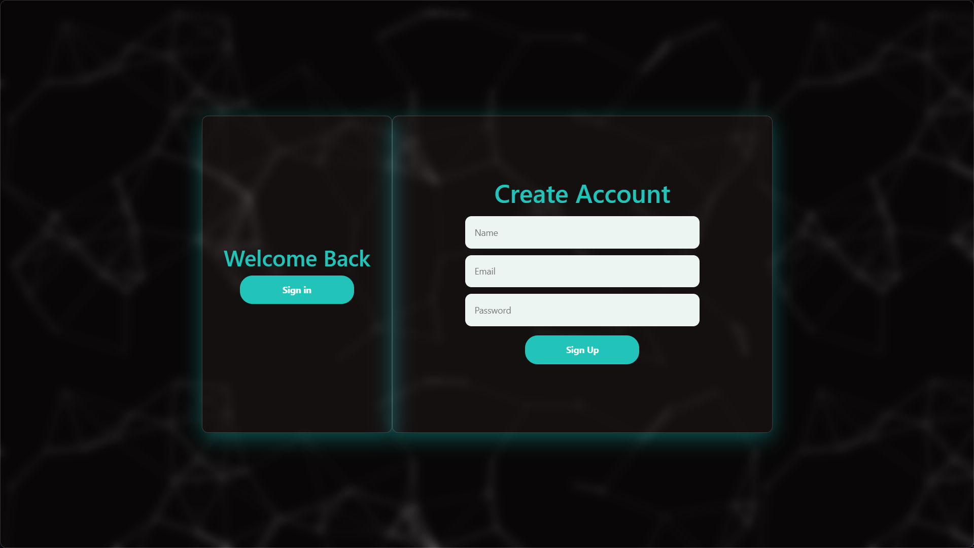

Slide 13
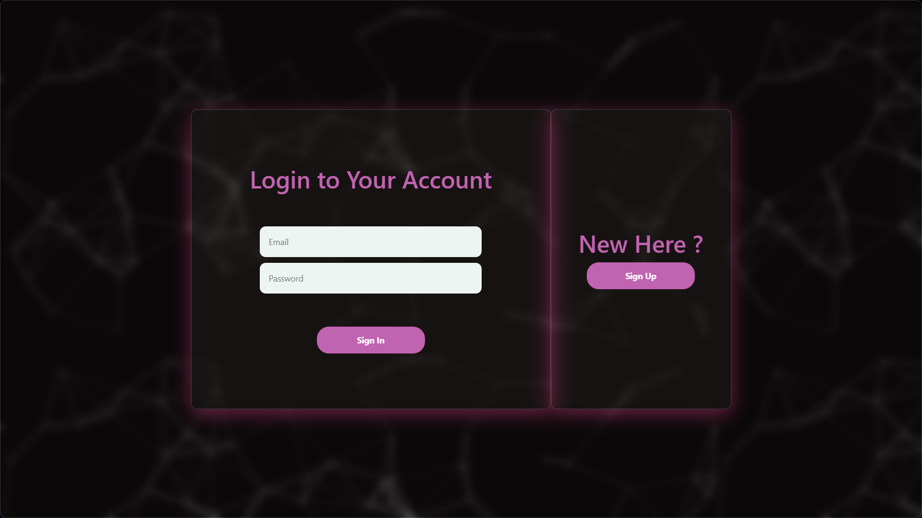

Slide 14
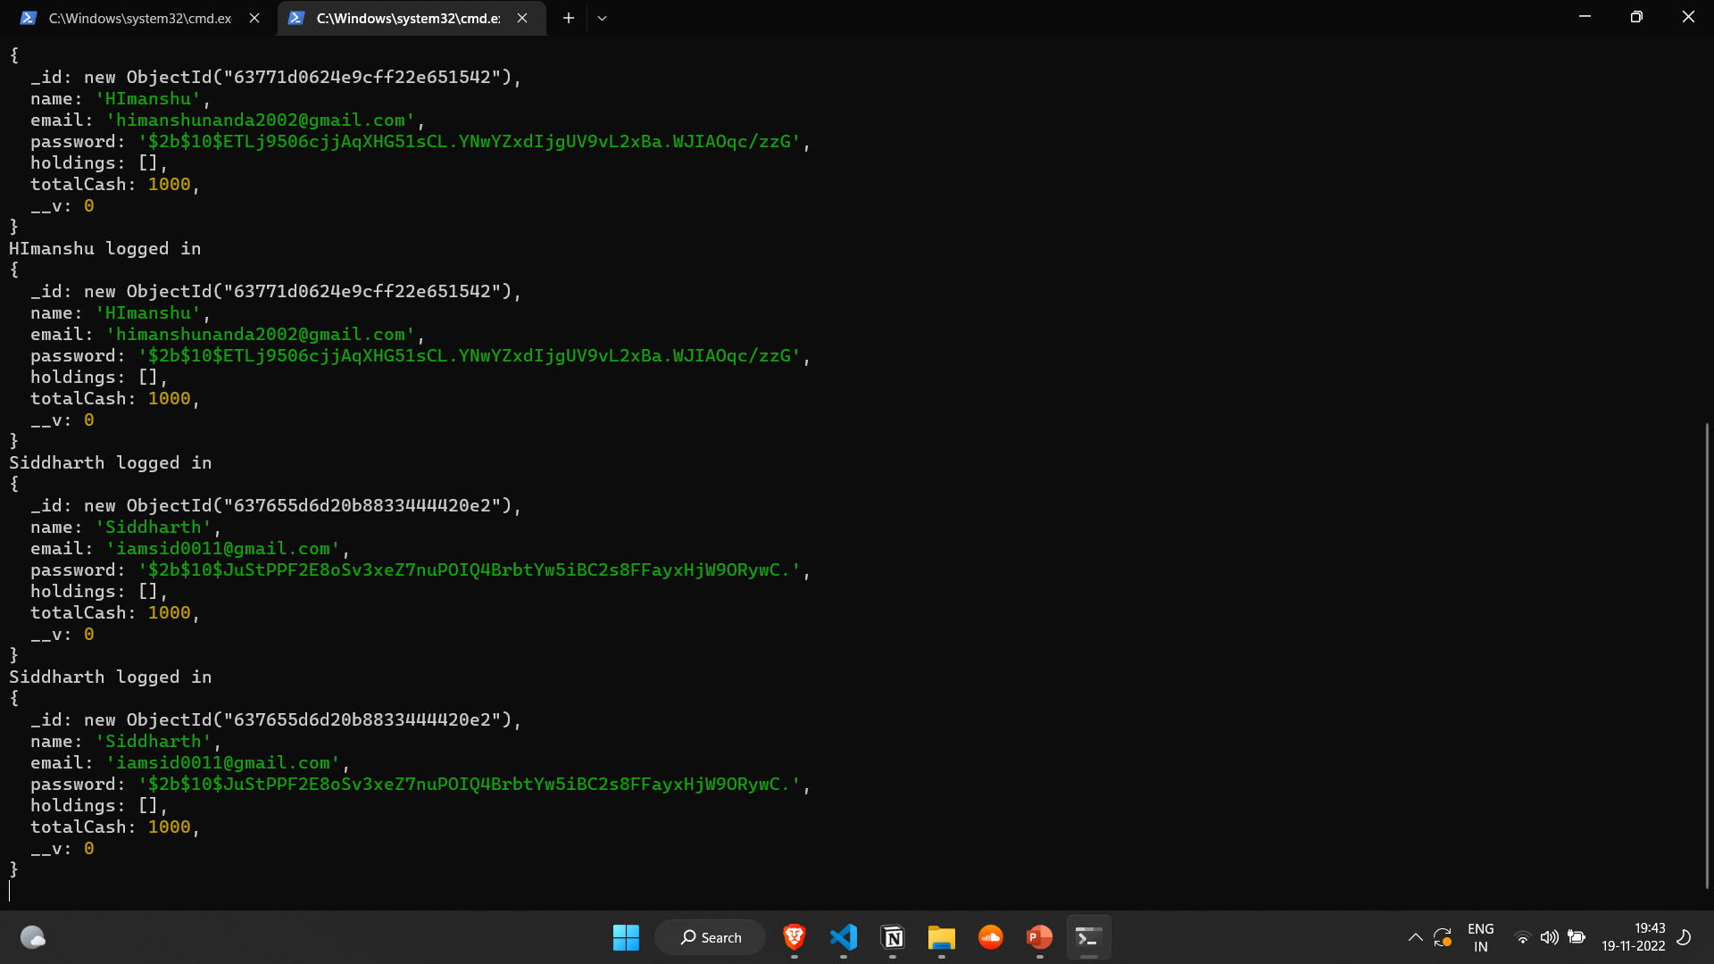
Server up and running

Slide 15
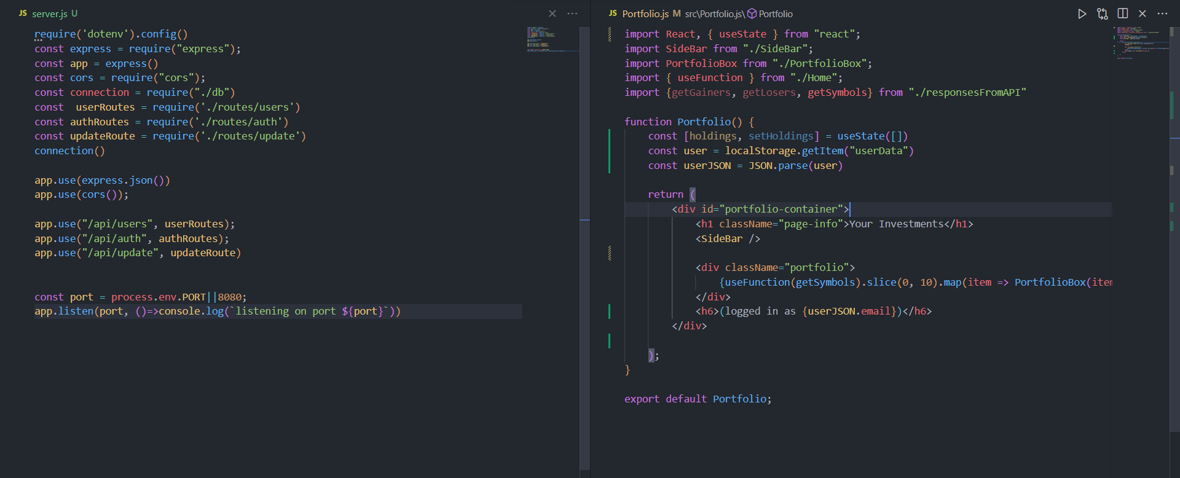
Server file
Portfolio page using react

Slide 16
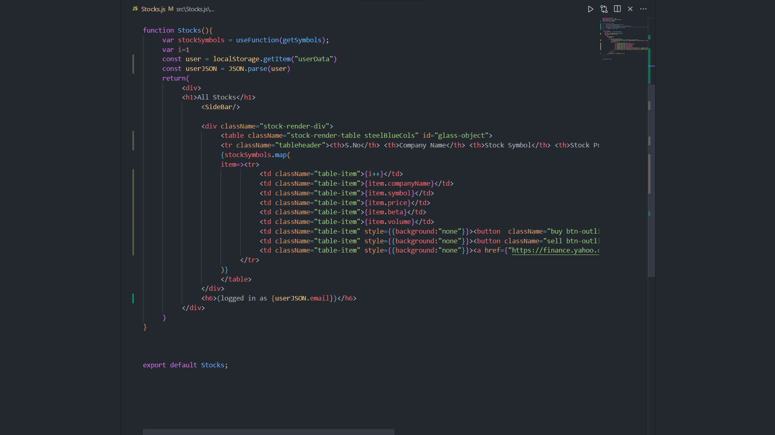
Rendering the stock table

Slide 17
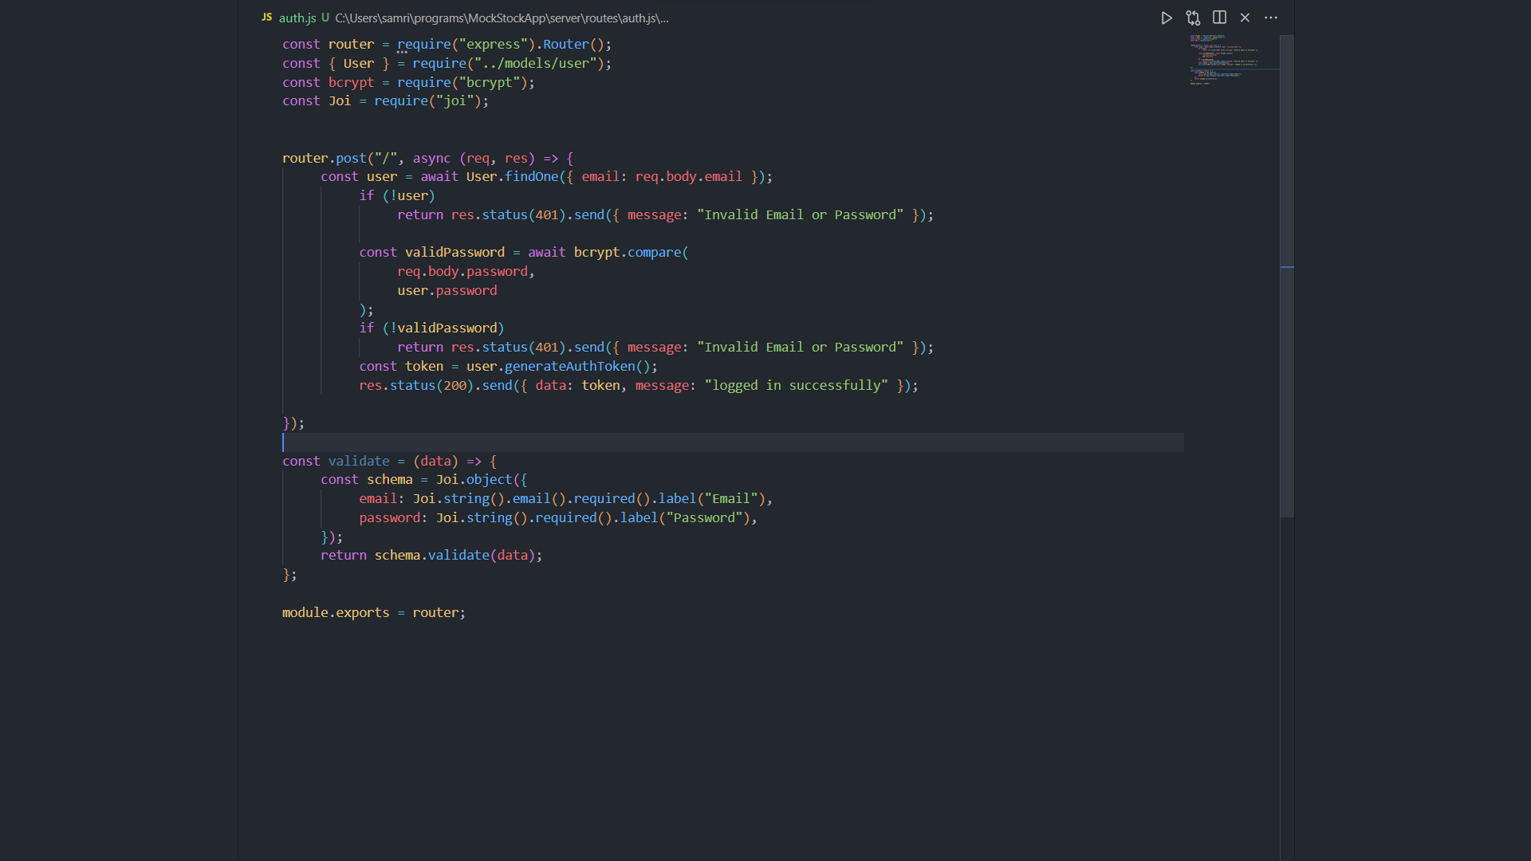
Authenticating the login

Slide 18
THANK YOU
To view the github repo of this project click here

